Slide 1
Introduction to Robotics Course no. 7
Andrei Dumitriu
andrei.dumitriu@fmi.unibuc.ro
Faculty of Mathematics and Computer Science
University of Bucharest

Slide 2
Today’s plan
Getting started
Short recap from last lab
Homework & Questions
8x8 LED Matrix
Scanning Multiplexing
MAX7219 driver

Slide 3
Homework

Slide 4
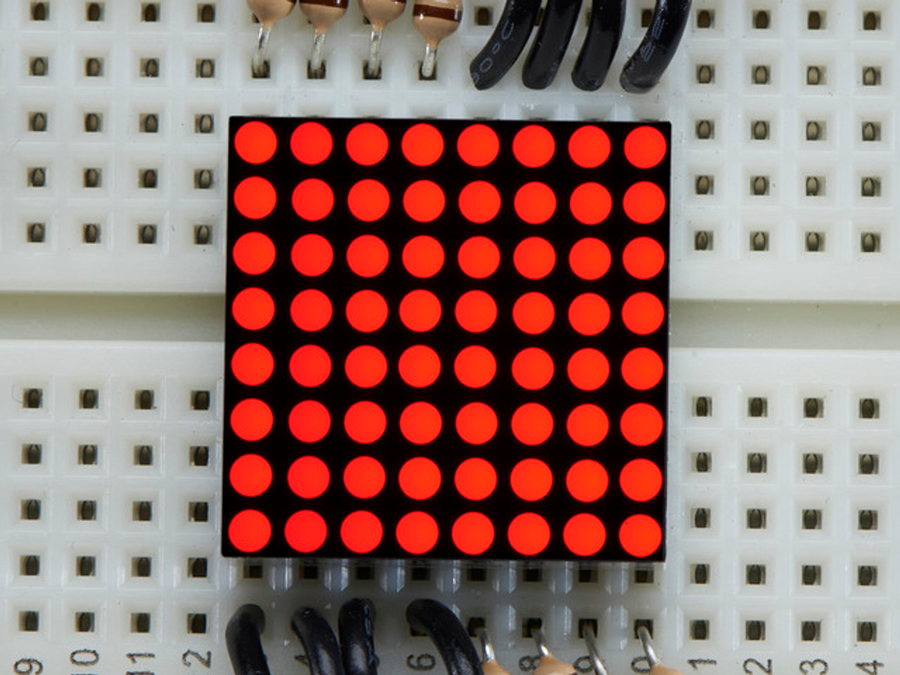
8x8 LED Matrix

Slide 5
8x8 LED Matrix
The 8x8 LED matrix is more present in your daily lives than you probably realise. It is used in industrial displays, destination signs in transports, danger signalization, clocks, sport displays and many more.

Slide 6
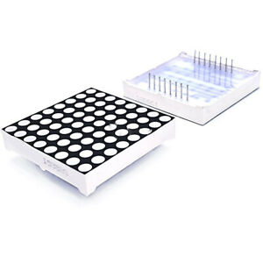
8x8 LED Matrix
It has 16 pins and 64 LEDs. In order to understand how this work, we need to look at the connections.

Slide 7
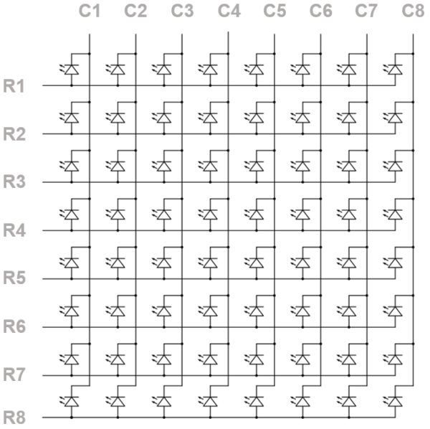
8x8 LED Matrix
In order to power a specific LED, we just need to apply 5v and 0v to the corresponding ROW and COLUMN combination

Slide 8
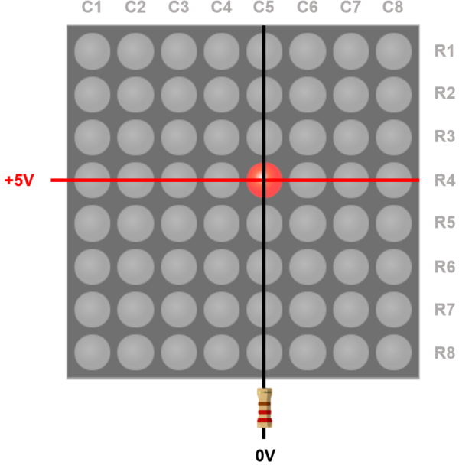
8x8 LED Matrix
In order to power a specific LED, we just need to apply 5v and 0v to the corresponding ROW and COLUMN combination

Slide 9
8x8 LED Matrix
In order to power a specific LED, we just need to apply 5v and 0v to the corresponding ROW and COLUMN combination

Slide 10
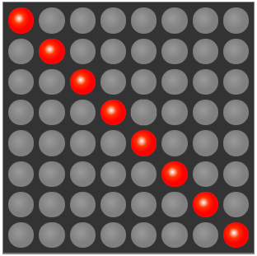
8x8 LED Matrix
But let’s think what happens if we want to light up this pattern.

Slide 11
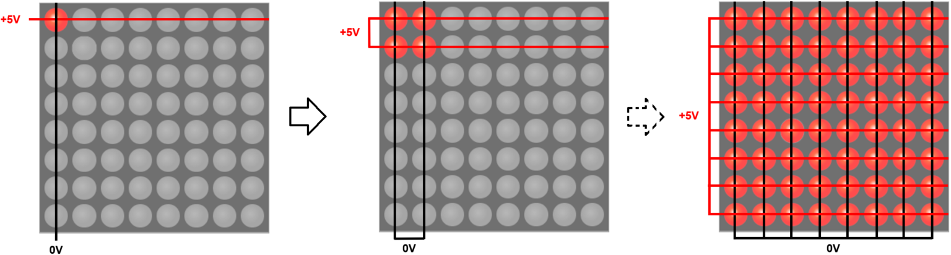
8x8 LED Matrix
We would actually get this

Slide 12
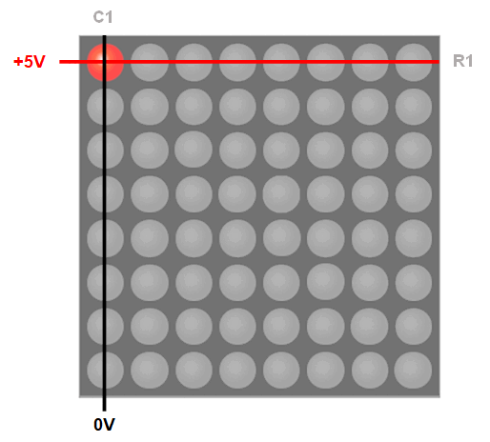
8x8 LED Matrix
Thus, enter multiplexing, again
https://www.youtube.com/watch?v=G4lIo-MRSiY

Slide 13
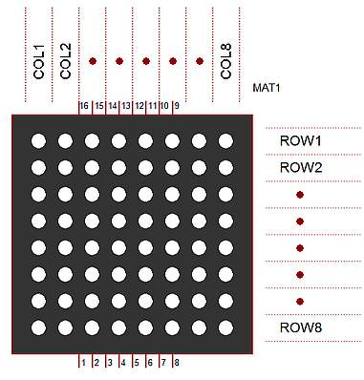
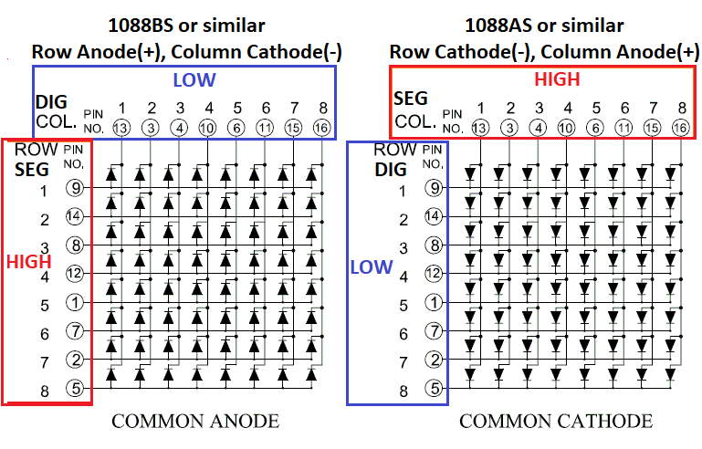
8x8 LED Matrix - types

Slide 14
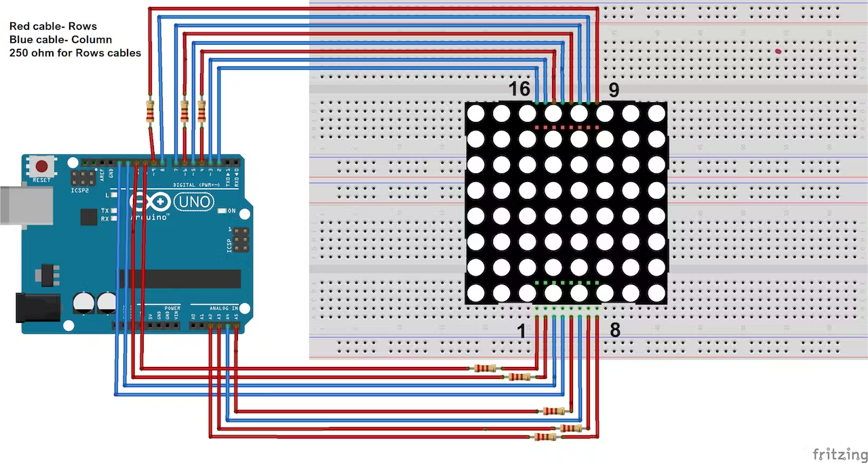
8x8 LED Matrix

Slide 15
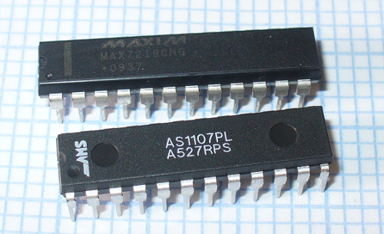
MAX7219
The MAX7219/MAX7221 are compact, serial input/output common-cathode display drivers that interface microprocessors (μPs) to 7-segment numeric LED displays of up to 8 digits, bar-graph displays, or 64 individual LEDs.
https://www.sparkfun.com/datasheets/Components/General/COM-09622-MAX7219-MAX7221.pdf

Slide 16
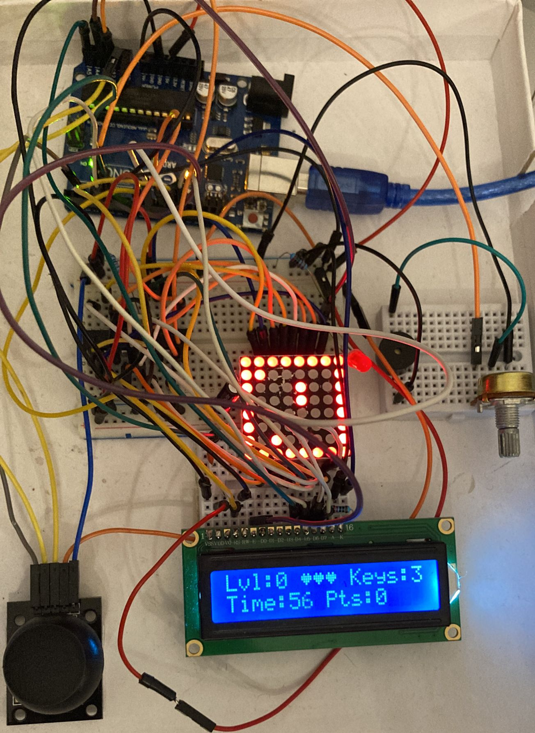
What you are going to use it for

